Slide 1


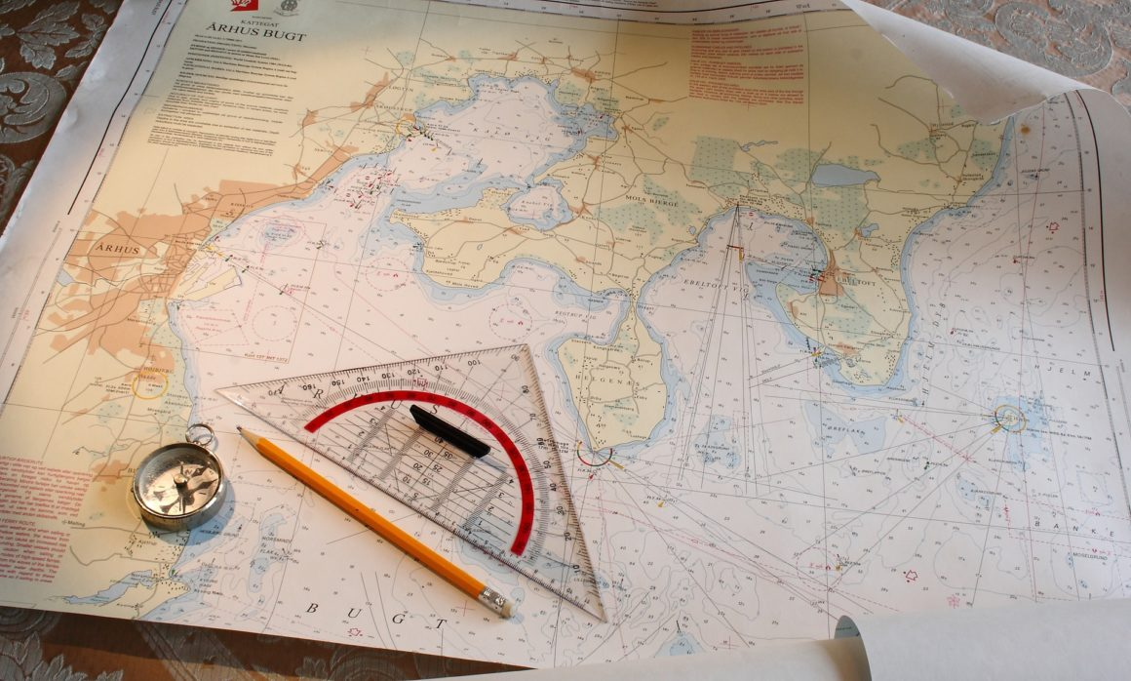
Track Preparation
NN220-06
SEANAV I United States Naval Academy
NN220 – Fundamentals of Navigation– Updated May 2023
Operations Officer I HMS PROTECTOR A173 I The Ice Patrol Ship

Slide 2
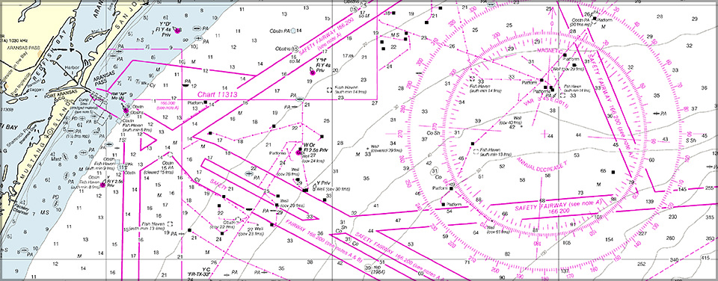
References
-The American Practical Navigator, Pub. No. 9, Bowditch, VOL. 1, 2019 Edition -Surface Ship Navigation Department Organizations and Regulations Manual (NAVDORM), COMNAVSURFPAC/COMNAVAIRPAC/COMNAVAIRLANT/COMNAVSURFLANT INSTRUCTION 3530.4 series -Chart Preparation Checklist
SEANAV I United States Naval Academy
NN220 – Fundamentals of Navigation
Operations Officer I HMS PROTECTOR A173 I The Ice Patrol Ship

Slide 3
Enabling Objectives
1 - DESCRIBE advance and transfer. 2 - FIND a turn point for a given waypoint using an advance and transfer table. 3 - EXPLAIN the use of a slide bar. 4 - LABEL a turn properly with a slide bar and range marks. 5 - DESCRIBE a turn bearing and how they are labeled. 6 - PLOT a turn bearing. 7 - DESCRIBE turn ranges and how they are labeled. 8 - PLOT a turn range. 9 - DESCRIBE how to shift to constants. 10 - EXPLAIN danger bearings. 11 - PLOT a danger bearing.
SEANAV I United States Naval Academy
NN220 – Fundamentals of Navigation
Operations Officer I HMS PROTECTOR A173 I The Ice Patrol Ship

Slide 4
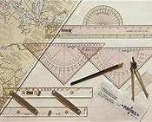
NAVKIT
-Ensure that you have the following instruments: Dividers Compasses Pencils and Erasers (A mechanical pencil is preferred due to the fine edge) Nautical Slide Rule (For quick and easy time, speed and distance calculations) Markers (Green, Yellow, Blue) Fine Edge Black Marker NAVAID Template Chart Correction Template All items should be available in your NAVKIT.
SEANAV I United States Naval Academy
NN220 – Fundamentals of Navigation
Operations Officer I HMS PROTECTOR A173 I The Ice Patrol Ship

Slide 5
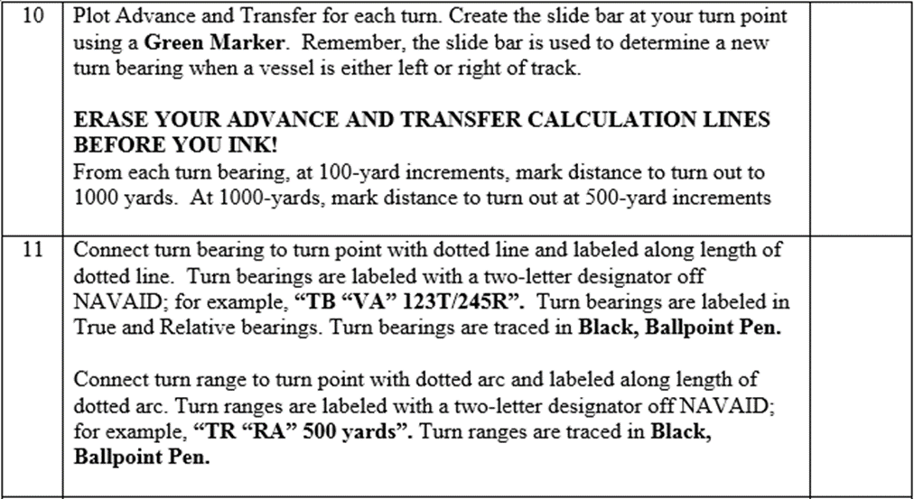
Chart Preparation Checklist
SEANAV I United States Naval Academy
NN220 – Fundamentals of Navigation
Operations Officer I HMS PROTECTOR A173 I The Ice Patrol Ship

Slide 6
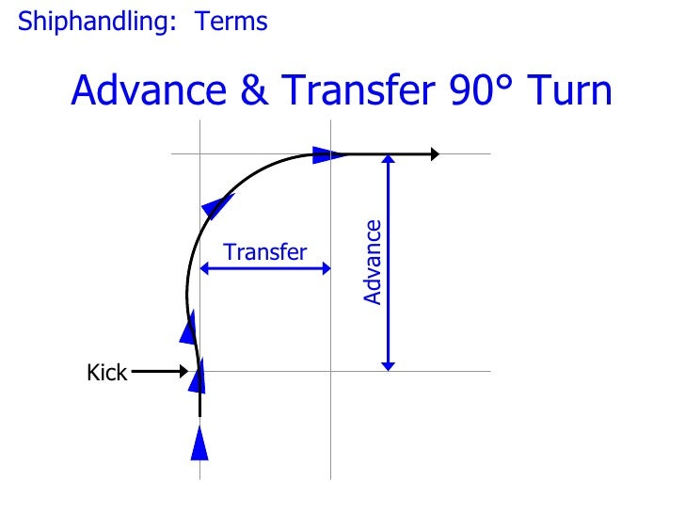
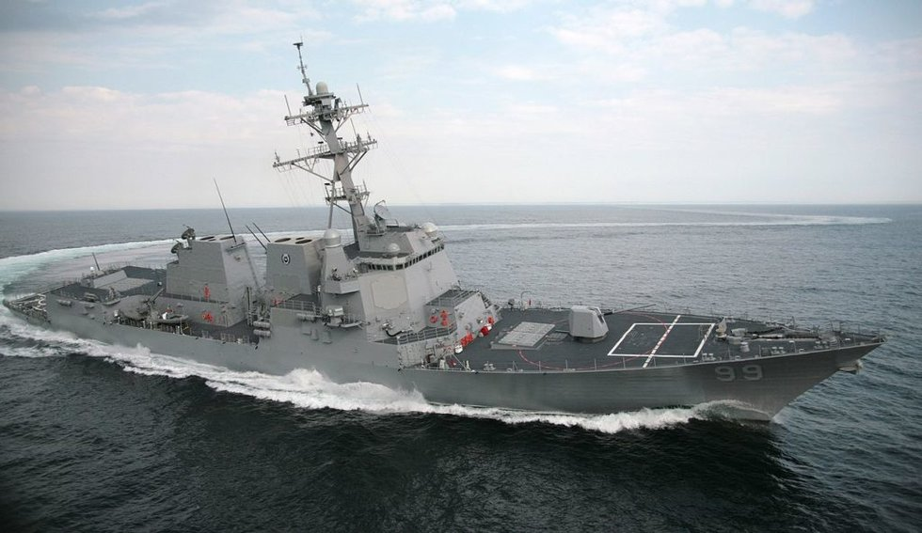
Advance and
Transfer
SEANAV I United States Naval Academy
NN220 – Fundamentals of Navigation
Operations Officer I HMS PROTECTOR A173 I The Ice Patrol Ship

Slide 7
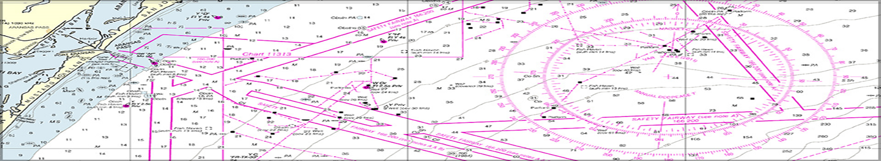

Advance and Transfer
C: 090T/080M
S: 10kts
D: 4,500yds
WP 1
C: 044T/034M
S: 10kts
D: 4,500yds
RB
VA
600 yards

Slide 8
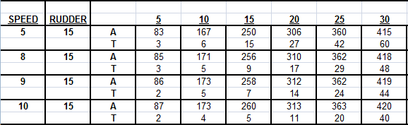
Advance and Transfer
Advance is the distance gained in the original directions until vessel steadies on her new course.
Transfer is the distance gained at right angles to the original course until vessel steadies on her new course.
Steady Point
Turn Point
Advance and Transfer are determined based on angle of turn, rudder angle and vessel’s speed. Every vessel has specific tactical data tables which represent turning characteristics based on these factors. Example below:
ANGLE OF TURN

Slide 9
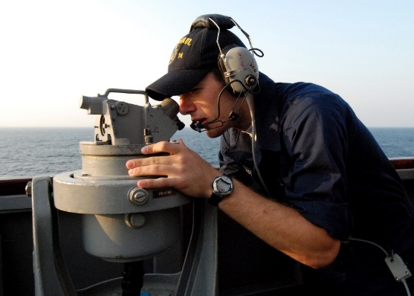
Turn Point, Slide Bar, and Turn Bearing
TR: “RB” 900yds
corrected
TR: “RB” 1,000yds
Steady Point
Turn Point
TB: “VA” 190T/100R
corrected
TB: “Visual Aid” XXXT/XXXR
XXXT = Direction from Turn Point to Turn Aid
XXXR = XXXT – Original Course (If negative number + 360)
TB: “VA” 180T/090R
TR: “RADAR Aid” XXXX YDS
RB
VA
Vessels are not always on track. Slide Bar assist the navigator in quickly revising a turn bearing if the vessel is off track just prior to a turn. Draw the slide bar parallel to the new course through the turning point of the original course.

Slide 10
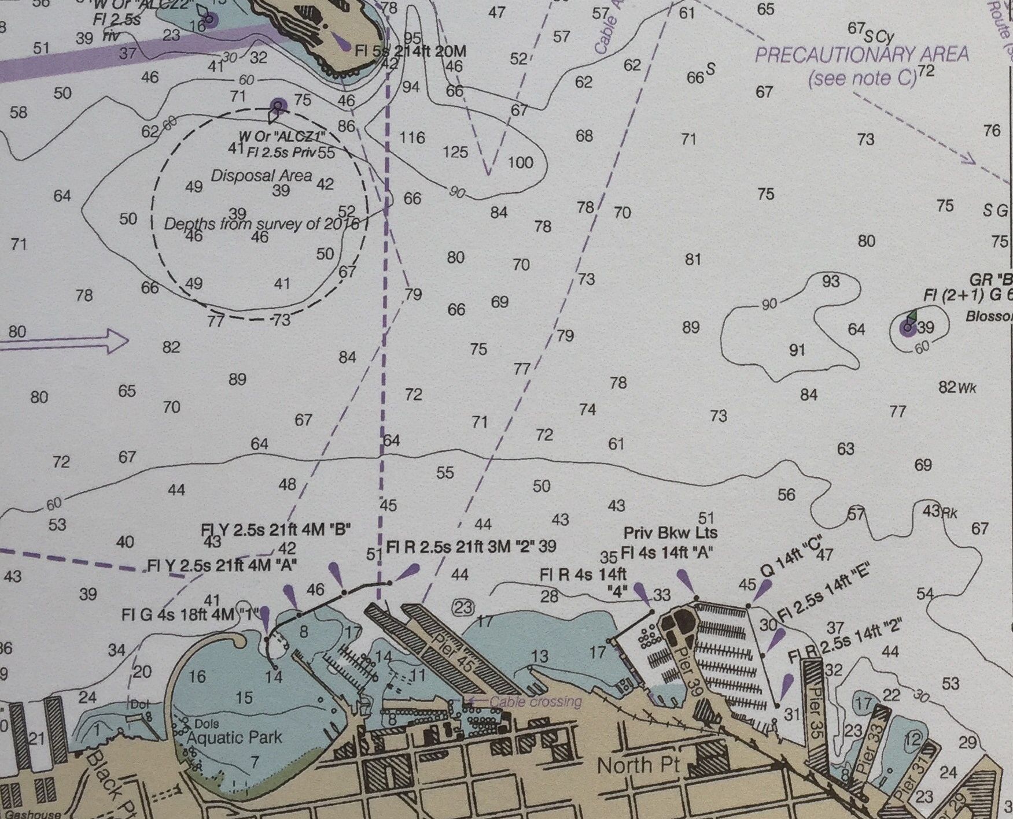
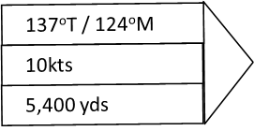
Slide Bar
Slide Bar tells when to turn if you are left or right of track.
090ºT / 077ºM
15kts
RD
Left off the track
5,950 yds
Turn point
Right off the track
VF
RC
10

Slide 11
Turn Point, Slide Bar, and Turn Bearing
When underway a navigation team is taking fixes at a duration of time. To accurately “mark a turn,” the navigator “shifts to constants” prior to a turn. This means that instead of taking fixes the navigation team will focus solely on the turn/range bearing.
After steadying on new course the navigation team will resume taking fixes.
“Shifting to Constants”
“Mark Turn”
0800
0803
500
400
300
200
100
“VA” 135T
“VA” 150T
“VA” 165T
TB: “VA” 180T/090R
VA
Select a Turn Bearing as close as possible off your beam. This will create the greatest rate of change of bearing and will result in a more precise turn. When selecting a Turn Range, select a RADAR aid as close to as possible off your bow/stern.

Slide 12
Determine Turn Bearing
Visual NAVAIDs off the beam will have a more rapid bearing change
and will provide a more precise LOP with which to mark your turn.
Bearing changes too slightly to know the exact timing to mark turn.
VB/RB
VA/RA
Bearing changes largely enough to know the exact timing to mark turn.
VD/RD
VC/RC
Bad for
Turn Bearing
Best for
Turn Bearing

Slide 13
Determine Turn Range
Radar NAVAIDs off the bow will have a more rapid range change and will provide a more precise LOP with which to mark your turn.
Range changes too slightly to know the exact timing to mark turn.
Bad for
Turn Range
You
VB/RB
VA/RA
Range changes largely enough to know the exact timing to mark turn.
VD/RD
VC/RC
Best for
Turn Range
13

Slide 14
How to determine Advance & Transfer? (1/6)
Use “Advance & Transfer Table”, which varies by ship type.
Speed
Rudder Angle
Amount of Turn from current to new course
SPEED | RUDDER | Angle of Turn from current to new course
 |  |  | 5 | 10 | 15 | 20 | 25 | 30 | 35 | 40 | 45 | 50 | 55
5 | 15 | A | 83 | 167 | 250 | 306 | 360 | 415 | 468 | 520 | 575 | 620 | 657
 |  | T | 3 | 6 | 15 | 27 | 42 | 60 | 83 | 105 | 135 | 162 | 189
8 | 15 | A | 85 | 171 | 256 | 310 | 362 | 418 | 469 | 524 | 575 | 620 | 659
 |  | T | 3 | 5 | 9 | 17 | 29 | 48 | 67 | 93 | 126 | 150 | 181
9 | 15 | A | 86 | 173 | 258 | 312 | 362 | 419 | 469 | 256 | 575 | 621 | 660
 |  | T | 2 | 5 | 7 | 14 | 24 | 44 | 61 | 89 | 123 | 146 | 178
10 | 15 | A | 87 | 173 | 260 | 313 | 363 | 420 | 470 | 527 | 575 | 621 | 661
 |  | T | 2 | 4 | 5 | 11 | 20 | 40 | 56 | 85 | 120 | 142 | 175
11 | 15 | A | 89 | 176 | 260 | 312 | 362 | 416 | 465 | 422 | 567 | 614 | 654
 |  | T | 2 | 5 | 9 | 15 | 25 | 44 | 61 | 90 | 125 | 148 | 181
12 | 15 | A | 90 | 179 | 260 | 311 | 361 | 412 | 460 | 417 | 559 | 607 | 647
 |  | T | 2 | 6 | 13 | 19 | 30 | 48 | 66 | 95 | 130 | 153 | 187
13 | 15 | A | 92 | 181 | 260 | 310 | 359 | 408 | 456 | 412 | 551 | 601 | 639
 |  | T | 2 | 8 | 17 | 24 | 35 | 52 | 70 | 100 | 135 | 159 | 194
14 | 15 | A | 93 | 184 | 260 | 309 | 358 | 404 | 451 | 407 | 543 | 594 | 632
 |  | T | 3 | 9 | 21 | 28 | 40 | 56 | 75 | 105 | 140 | 164 | 200
15 | 15 | A | 95 | 187 | 260 | 308 | 357 | 400 | 446 | 502 | 535 | 587 | 625
 |  | T | 3 | 10 | 25 | 32 | 45 | 60 | 80 | 110 | 145 | 170 | 206
14

Slide 15
How to determine Advance & Transfer? (2/6)
Q1: What are Advance and Transfer if you turn at 15kts with standard rudder from 090°T to 137°T?
1) Find your speed, rudder angle and Amount of Turn on the table.
2) Advance and Transfer for 47° turn should be between the ones of 45° and 50°.
45°
535(yds)
Advance:
47°
? (yds)
50°
587(yds)
137°- 090°
SPEED | RUDDER | Angle of Turn from current to new course
 |  |  | 5 | 10 | 15 | 20 | 25 | 30 | 35 | 40 | 45 | 50 | 55
14 | 15 | A | 93 | 184 | 260 | 309 | 358 | 404 | 451 | 407 | 543 | 594 | 632
 |  | T | 3 | 9 | 21 | 28 | 40 | 56 | 75 | 105 | 140 | 164 | 200
15 | 15 | A | 95 | 187 | 260 | 308 | 357 | 400 | 446 | 502 | 535 | 587 | 625
 |  | T | 3 | 10 | 25 | 32 | 45 | 60 | 80 | 110 | 145 | 170 | 206
5 | 30 | A | 55 | 110 | 165 | 202 | 235 | 275 | 307 | 335 | 365 | 392 | 417
 |  | T | 0 | 0 | 0 | 6 | 11 | 20 | 29 | 38 | 50 | 63 | 78
8 | 30 | A | 41 | 82 | 123 | 149 | 175 | 203 | 225 | 246 | 266 | 286 | 303
 |  | T | 1 | 3 | 6 | 10 | 16 | 23 | 37 | 48 | 65 | 178 | 92
47°
15

Slide 16
How to determine Advance & Transfer? (3/6)
Q1: What are Advance and Transfer if you turn at 15kts with standard rudder from 090°T to 137°T?
3) Determine Advance for 47° turn.
535 + (587 – 535 ) / (50 – 45)*2 = 535 + 10.4*2 = 555.8 (yds)
Advance per 1 °
4) Determine Transfer for 47° turn in same way as for Advance.
145 + (170 – 145) / (50-45)*2 = 145 + 5*2
= 155 (yds)
Transfer per 1 °
SPEED | RUDDER | Angle of Turn from current to new course
 |  |  | 5 | 10 | 15 | 20 | 25 | 30 | 35 | 40 | 45 | 50 | 55
14 | 15 | A | 93 | 184 | 260 | 309 | 358 | 404 | 451 | 407 | 543 | 594 | 632
 |  | T | 3 | 9 | 21 | 28 | 40 | 56 | 75 | 105 | 140 | 164 | 200
15 | 15 | A | 95 | 187 | 260 | 308 | 357 | 400 | 446 | 502 | 535 | 587 | 625
 |  | T | 3 | 10 | 25 | 32 | 45 | 60 | 80 | 110 | 145 | 170 | 206
5 | 30 | A | 55 | 110 | 165 | 202 | 235 | 275 | 307 | 335 | 365 | 392 | 417
 |  | T | 0 | 0 | 0 | 6 | 11 | 20 | 29 | 38 | 50 | 63 | 78
8 | 30 | A | 41 | 82 | 123 | 149 | 175 | 203 | 225 | 246 | 266 | 286 | 303
 |  | T | 1 | 3 | 6 | 10 | 16 | 23 | 37 | 48 | 65 | 178 | 92
16

Slide 17
How to determine Advance & Transfer? (4/6)
Q2: What are Advance and Transfer if you turn at 9kts with standard rudder from 090°T to 113°T?
SPEED | RUDDER | Angle of Turn from current to new course
 |  |  | 5 | 10 | 15 | 20 | 25 | 30 | 35 | 40 | 45 | 50 | 55
5 | 15 | A | 83 | 167 | 250 | 306 | 360 | 415 | 468 | 520 | 575 | 620 | 657
 |  | T | 3 | 6 | 15 | 27 | 42 | 60 | 83 | 105 | 135 | 162 | 189
8 | 15 | A | 85 | 171 | 256 | 310 | 362 | 418 | 469 | 524 | 575 | 620 | 659
 |  | T | 3 | 5 | 9 | 17 | 29 | 48 | 67 | 93 | 126 | 150 | 181
9 | 15 | A | 86 | 173 | 258 | 312 | 362 | 419 | 469 | 256 | 575 | 621 | 660
 |  | T | 2 | 5 | 7 | 14 | 24 | 44 | 61 | 89 | 123 | 146 | 178
10 | 15 | A | 87 | 173 | 260 | 313 | 363 | 420 | 470 | 527 | 575 | 621 | 661
 |  | T | 2 | 4 | 5 | 11 | 20 | 40 | 56 | 85 | 120 | 142 | 175
11 | 15 | A | 89 | 176 | 260 | 312 | 362 | 416 | 465 | 422 | 567 | 614 | 654
 |  | T | 2 | 5 | 9 | 15 | 25 | 44 | 61 | 90 | 125 | 148 | 181
12 | 15 | A | 90 | 179 | 260 | 311 | 361 | 412 | 460 | 417 | 559 | 607 | 647
 |  | T | 2 | 6 | 13 | 19 | 30 | 48 | 66 | 95 | 130 | 153 | 187
13 | 15 | A | 92 | 181 | 260 | 310 | 359 | 408 | 456 | 412 | 551 | 601 | 639
 |  | T | 2 | 8 | 17 | 24 | 35 | 52 | 70 | 100 | 135 | 159 | 194
14 | 15 | A | 93 | 184 | 260 | 309 | 358 | 404 | 451 | 407 | 543 | 594 | 632
 |  | T | 3 | 9 | 21 | 28 | 40 | 56 | 75 | 105 | 140 | 164 | 200
15 | 15 | A | 95 | 187 | 260 | 308 | 357 | 400 | 446 | 502 | 535 | 587 | 625
 |  | T | 3 | 10 | 25 | 32 | 45 | 60 | 80 | 110 | 145 | 170 | 206
17

Slide 18
How to determine Advance & Transfer? (5/6)
Q2: What are Advance and Transfer if you turn at 9kts with standard rudder from 090°T to 113°T?
1) Find your speed, rudder angle and Amount of Turn on the table.
2) Advance and Transfer for 23° turn should be between the ones of 20° and 25°.
20°
312(yds)
Advance:
23°
? (yds)
25°
362(yds)
113°- 090°
23°
SPEED | RUDDER | Angle of Turn from current to new course
 |  |  | 5 | 10 | 15 | 20 | 25 | 30 | 35 | 40 | 45 | 50 | 55
9 | 15 | A | 86 | 173 | 258 | 312 | 362 | 419 | 469 | 256 | 575 | 621 | 660
 |  | T | 2 | 5 | 7 | 14 | 24 | 44 | 61 | 89 | 123 | 146 | 178
18

Slide 19
How to determine Advance & Transfer? (6/6)
Q2: What are Advance and Transfer if you turn at 9kts with standard rudder from 090°T to 113°T?
3) Determine Advance for 23° turn.
312 + (362 – 312 ) / (25 – 20)*3 = 312 + 10*3
= 342 (yds)
4) Determine Transfer for 23° turn in same way as for Advance.
14 + ( 24 – 14) / (25 – 20)*3 = 14 + 2*3
= 20 (yds)
SPEED | RUDDER | Angle of Turn from current to new course
 |  |  | 5 | 10 | 15 | 20 | 25 | 30 | 35 | 40 | 45 | 50 | 55
9 | 15 | A | 86 | 173 | 258 | 312 | 362 | 419 | 469 | 256 | 575 | 621 | 660
 |  | T | 2 | 5 | 7 | 14 | 24 | 44 | 61 | 89 | 123 | 146 | 178
19

Slide 20
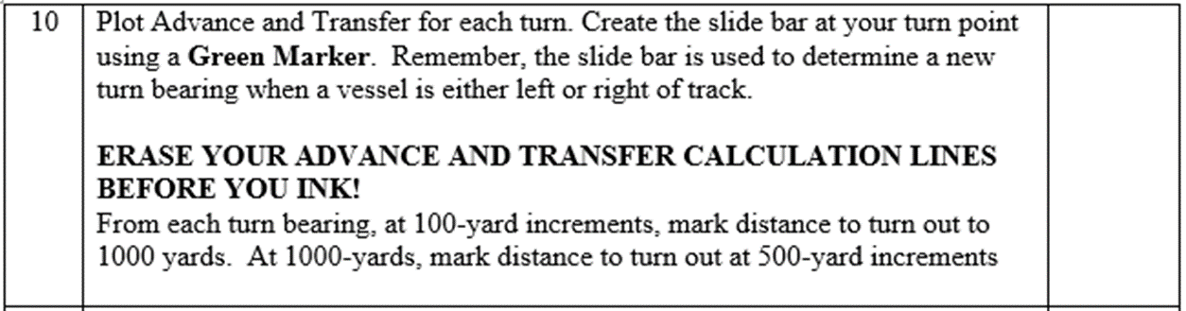
Plot a Slide Bar and Range Marks
SEANAV I United States Naval Academy
NN220 – Fundamentals of Navigation
Operations Officer I HMS PROTECTOR A173 I The Ice Patrol Ship

Slide 21
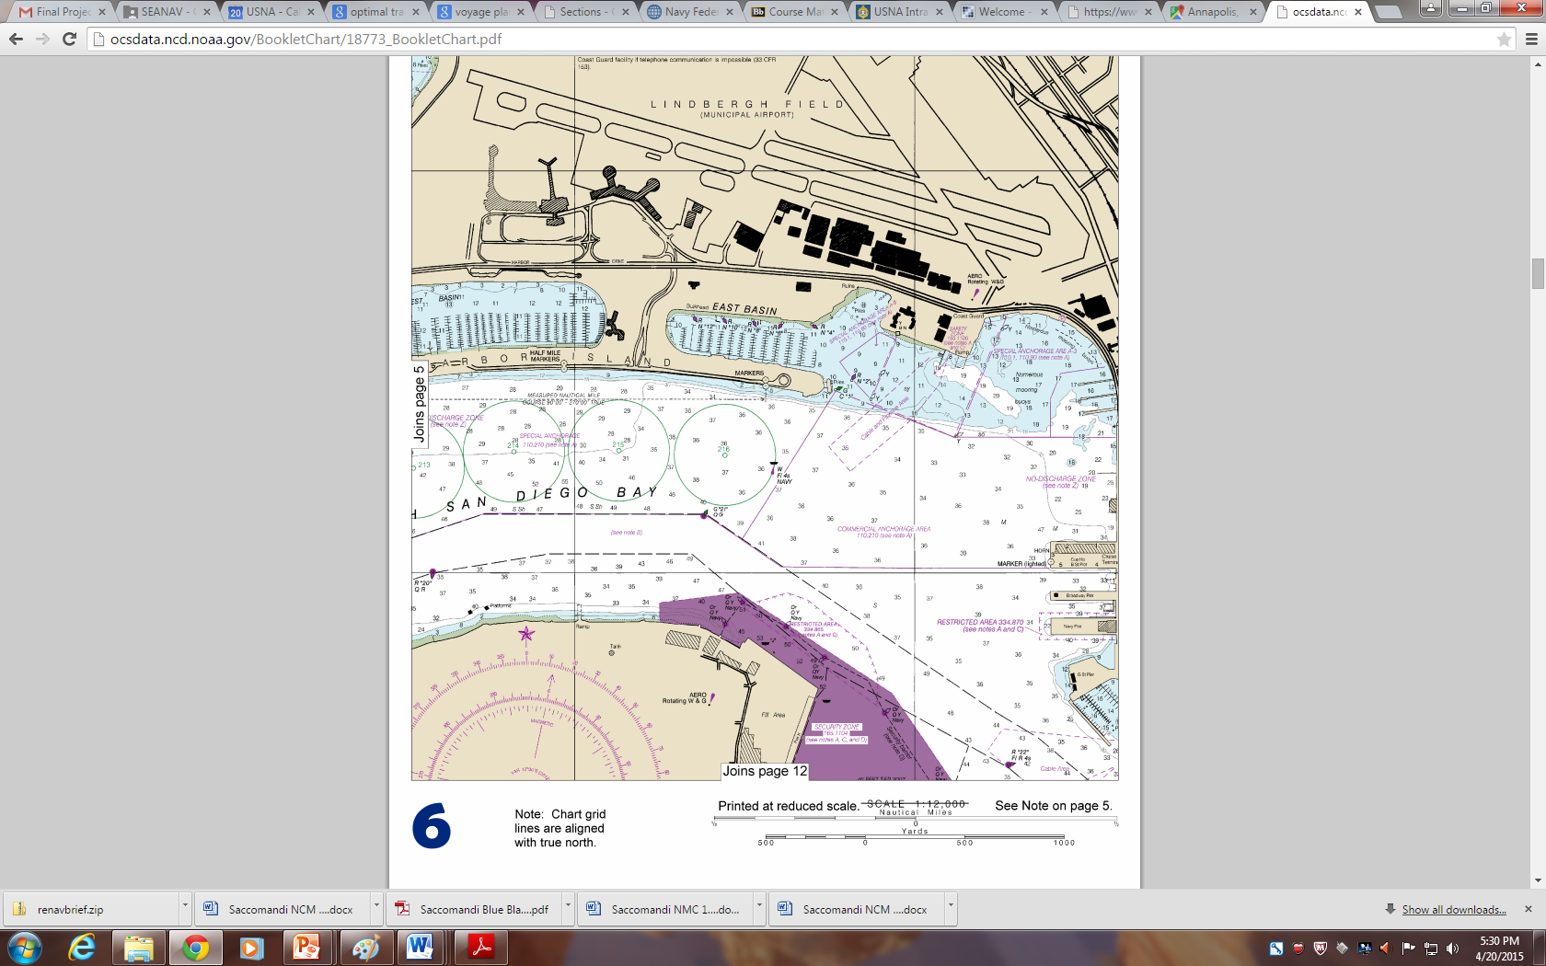
VA
RA
90
270
90
270
124°T / 112°M
90
3,200 yds
270
6 kts
Advance
50
VC
Transfer
300
Transfer
800
700
600
400
200
100
500
RC
RD
090°T / 078°M
1,200 yds
6 kts
VB

Slide 22
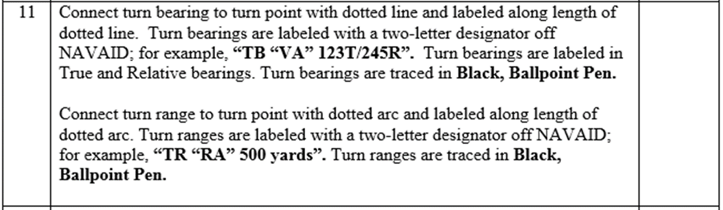
Turn Bearing / Turn Range
SEANAV I United States Naval Academy
NN220 – Fundamentals of Navigation
Operations Officer I HMS PROTECTOR A173 I The Ice Patrol Ship

Slide 23
VA
Turn ranges are ideal off the bow or stern, where range change happens quickly
RA
124°T / 112°M
3,200 yds
160
340
6 kts
TB:“VA” 340°T / 250°R
TR:“RC” 1,900 yds
50
VC
RC
RD
Turn bearings are ideal off the beams, where bearing change happens quickly
090°T / 078°M
1,200 yds
6 kts
VB

Slide 24
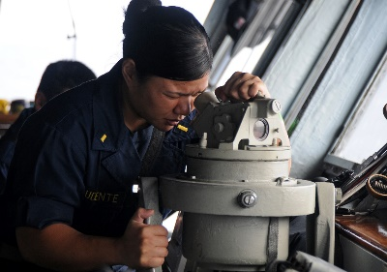
Danger Bearing
“VA” 105T
NLT
DB: “VB” _____ 100T
“VA” 095T
VB
VA
Danger Bearings are used by the navigator to keep clear of an area of danger close to which the vessel must pass. It is established between two fixed objects (danger area and navigation aid). The navigation aid should be in the same general direction of the course when passing the danger.
600 yards

Slide 25
Anchorage Plotting
Approach Track is defined as the track that a vessel must make good in order to arrive at the center of her assigned berth.
Head Bearing (HB) is a bearing to a visual aid from the approach track. The anchorage point should be chosen by finding a HB that will exactly match the approach course. If you don’t have a HB, move the anchorage point or change the course!
HB: “VA” 090T/080M
090°T / 078°M
1,000 yds
6 kts

Slide 26
Anchorage Plotting
Hawsepipe to Peloris
“Let Go Anchor”
LGC
Since the location where the navigator is taking bearing from is not the same location that the anchor is let go, the letting-go-circle (LGC) is drawn around the planned anchorage. LGC = distance between the hawsepipe and the pelorus.
The let-go-bearing (LGB) is a bearing to a visual aid from the point of intersection of the LGC and approach track.
LGB: “VB” 185T/095R

Slide 27
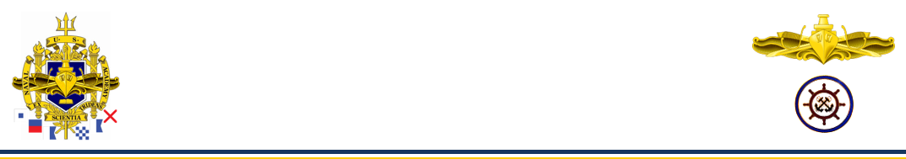
Anchorage Plotting
Drag Circle is plotted from the actual anchorage position as the center and the radius is equal to the sum of the distance of the hawespipe to pelorus and the amount of anchor chain let out rounded to the next whole shot. All fixes following anchorage should fall within this circle or the anchor is dragging. HAWSEPIPE TO PELORUS + LENGTH OF CHAIN = DRAG CIRCLE
Swing Circle is plotted from the actual anchorage position as the center and the radius is equal to the sum of the distance of the length of ship and the amount of anchor chain let out. Its purpose is to ensure the ship will be in safe water while anchored. LENGTH OF CHAIN + LENGTH OF SHIP = SWING CIRCLE

Slide 28
Anchorage Plotting
C: 130T/120M
D: 1,000 yds
C: 090T/080M
S: 10 kts
D: 5,000 yds
500
-Depth of Water: Required to let out 5-7 x depth of water
-Bottom Type: Mud, Sand are ideal
-Traffic Density: Away from heavy traffic
-Safe for Navigation: When anchored the swing circle (length of chain + length of ship) falls in safe waters
-Identify navaid to use as HB and another for use as LGB. HB is in Degrees True and Magnetic. Ensure Approach Track and HB match!
400
-Measure and plot the radius of the letting-go circle (Hawespipe to Pelorus) over center of anchorage.
-Scribe and lable the range arcs on chart (100-1000, 1200, 1500, 2000 yds) starting from the LGC.
-Plot and label LGB from the LGC to the applicable navaid. Degrees True and Relative!
300
80 85 S 75 S 72 65
55 46 M 44
S 40 41
33 39 M 40 M
Co 38 40
200
100
LGC
HB: “VA” 130T/120M
LGB: “VB” 220T/090R
VA
VB
SHIP’S CHARACTERISTICS:
Ship Length: 300 feet
Hawespipe to Pelorus: 100 feet
1,200 yards

Slide 29
Anchorage Plotting
Only plot the swing/drag circles AFTER you anchor. In other words, DO NOT prep your chart with the swing and drag circle already plotted
Following anchorage plot drag and swing circle. Take 3 consecutive fixes ensuring they fall within the drag circle.
0806
0803
0800
If a fix plots outside the drag circle then you are dragging anchor. Raise the anchor and then try to anchor again.
Anchor
Drag
Swing
VA
VB
SHIP’S CHARACTERISTICS:
Ship Length: 300 feet
Hawespipe to Pelorus: 100 feet
1,200 yards

Slide 30
Enabling Objectives
1 - DESCRIBE advance and transfer. 2 - FIND a turn point for a given waypoint using an advance and transfer table. 3 - EXPLAIN the use of a slide bar. 4 - LABEL a turn properly with a slide bar and range marks. 5 - DESCRIBE a turn bearing and how they are labeled. 6 - PLOT a turn bearing. 7 - DESCRIBE turn ranges and how they are labeled. 8 - PLOT a turn range. 9 - DESCRIBE how to shift to constants. 10 - EXPLAIN danger bearings. 11 - PLOT a danger bearing.
SEANAV I United States Naval Academy
NN220 – Fundamentals of Navigation
Operations Officer I HMS PROTECTOR A173 I The Ice Patrol Ship

Slide 31
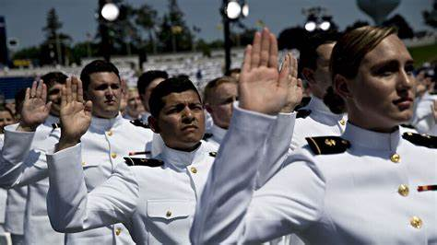
Questions?
SEANAV I United States Naval Academy
NN220 – Fundamentals of Navigation
Operations Officer I HMS PROTECTOR A173 I The Ice Patrol Ship

